Slide 1
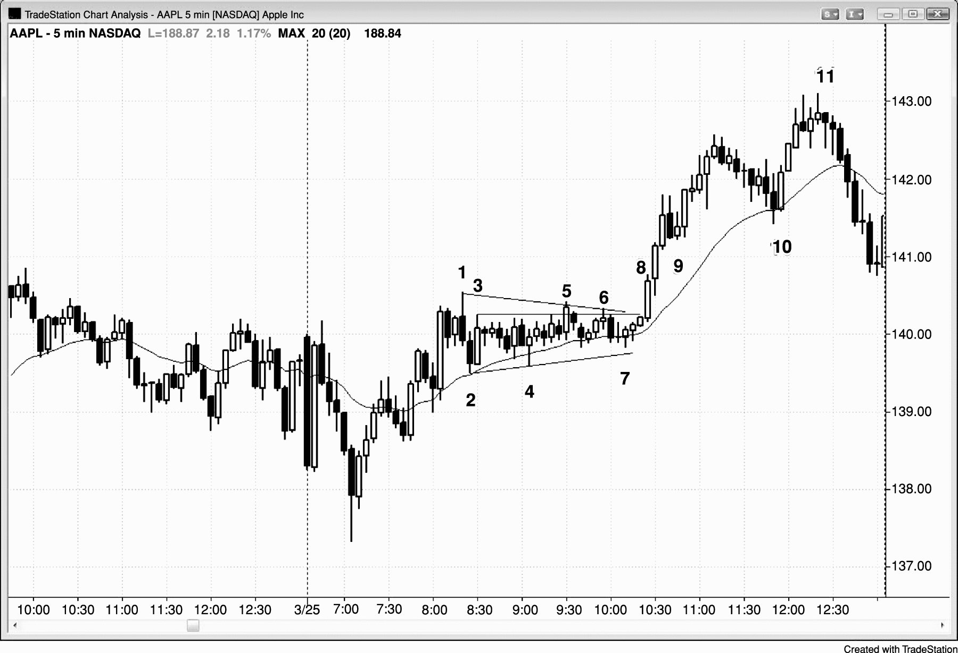
FIGURE 22.1 Tight Trading Range

Slide 2
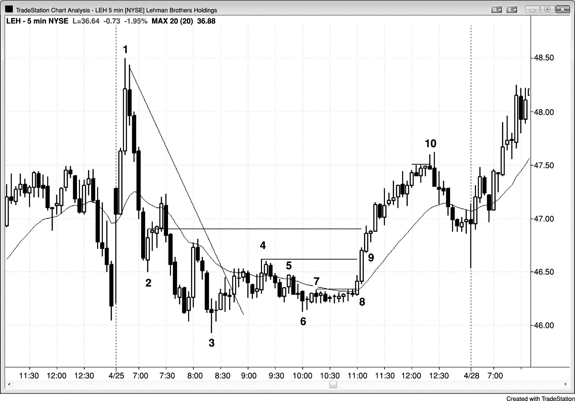
FIGURE 22.2 Tight Trading Range in Both Bull and Bear Legs

Slide 3
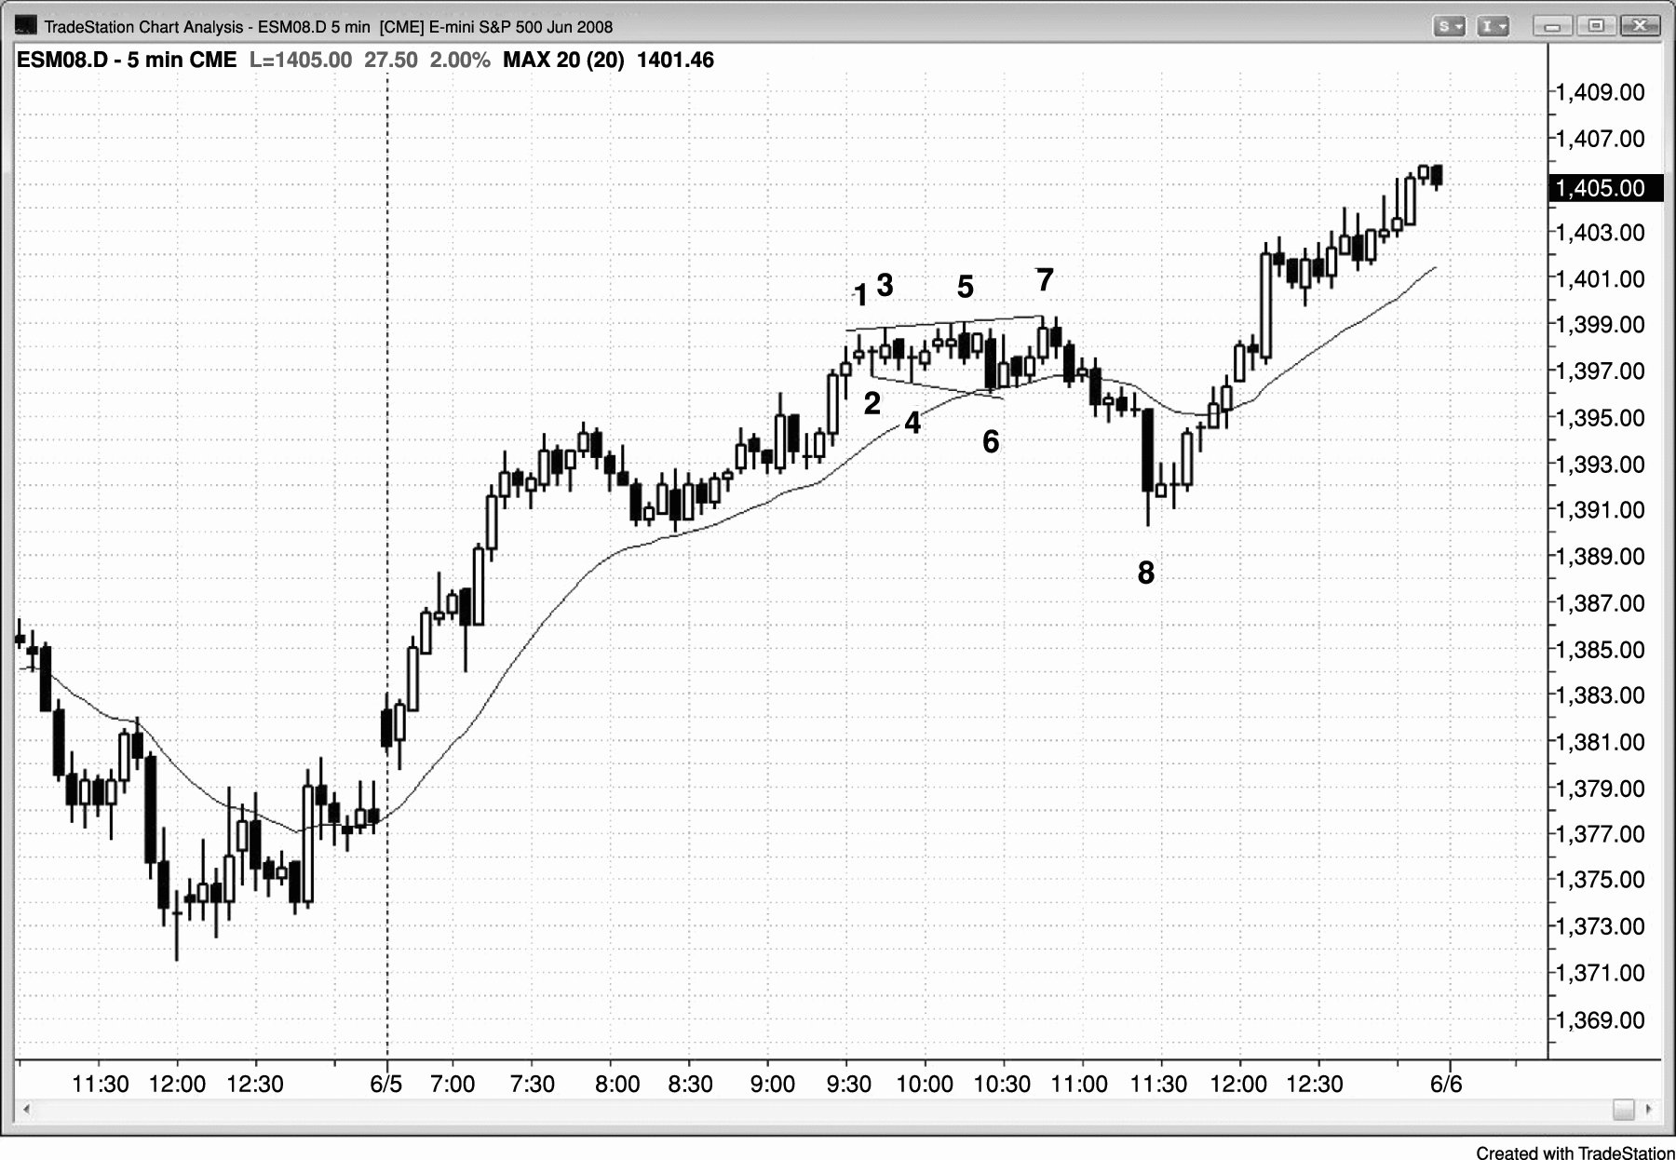
FIGURE 22.3 Tight Trading Range Evolving into Larger Trading Range

Slide 4
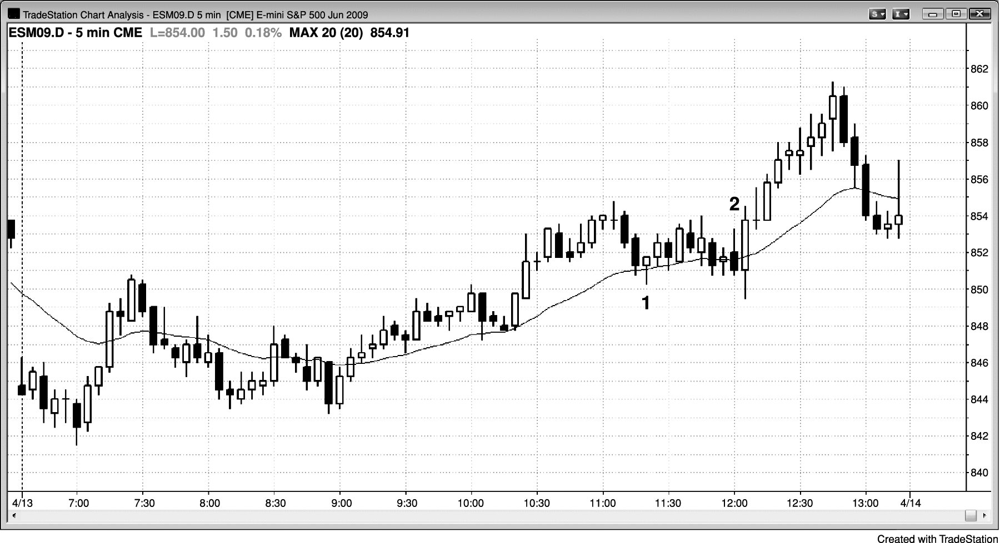
FIGURE 22.4 Stop Entries in Barbwire Are Costly

Slide 5
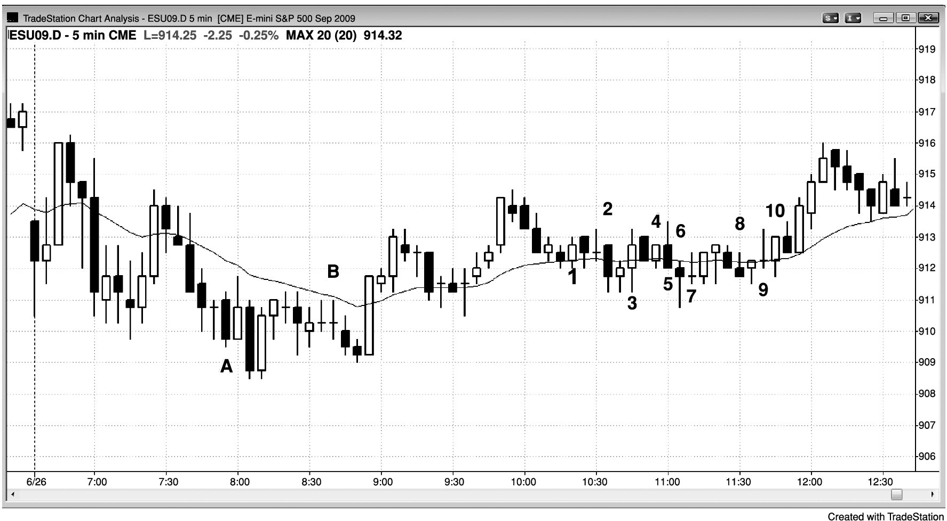
FIGURE 22.5 Stop Entries Would Have Yielded 10 Consecutive Losers

Slide 6
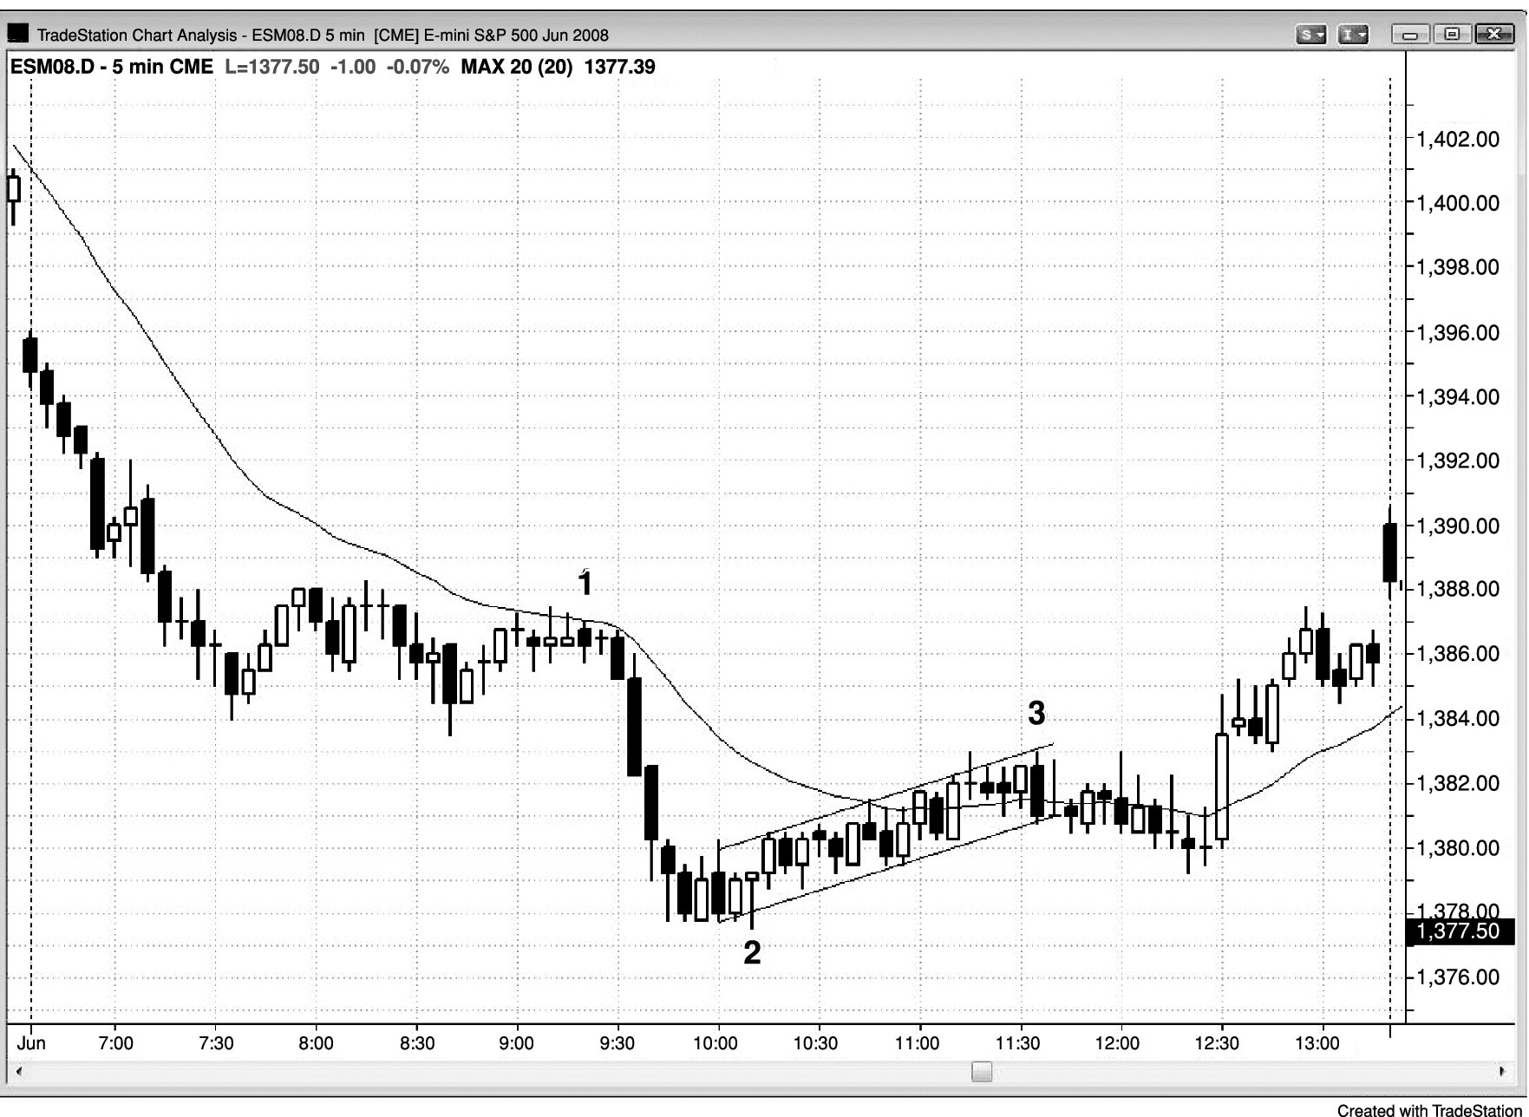
FIGURE 22.6 Sloping Tight Trading Range

Slide 7
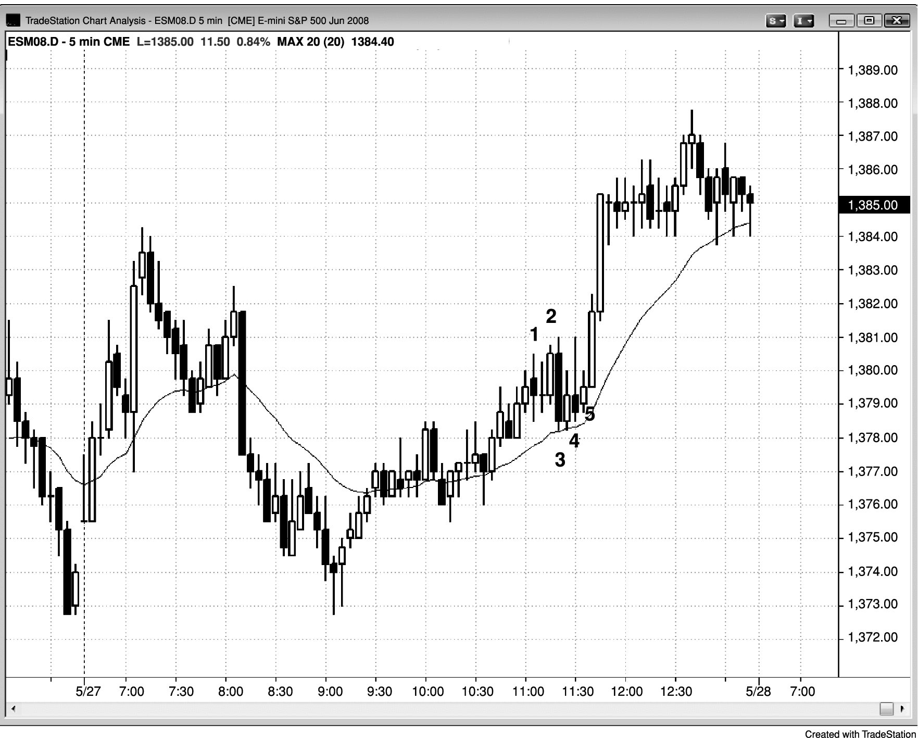
FIGURE 22.7 Barbwire with an ioi Pattern

Slide 8
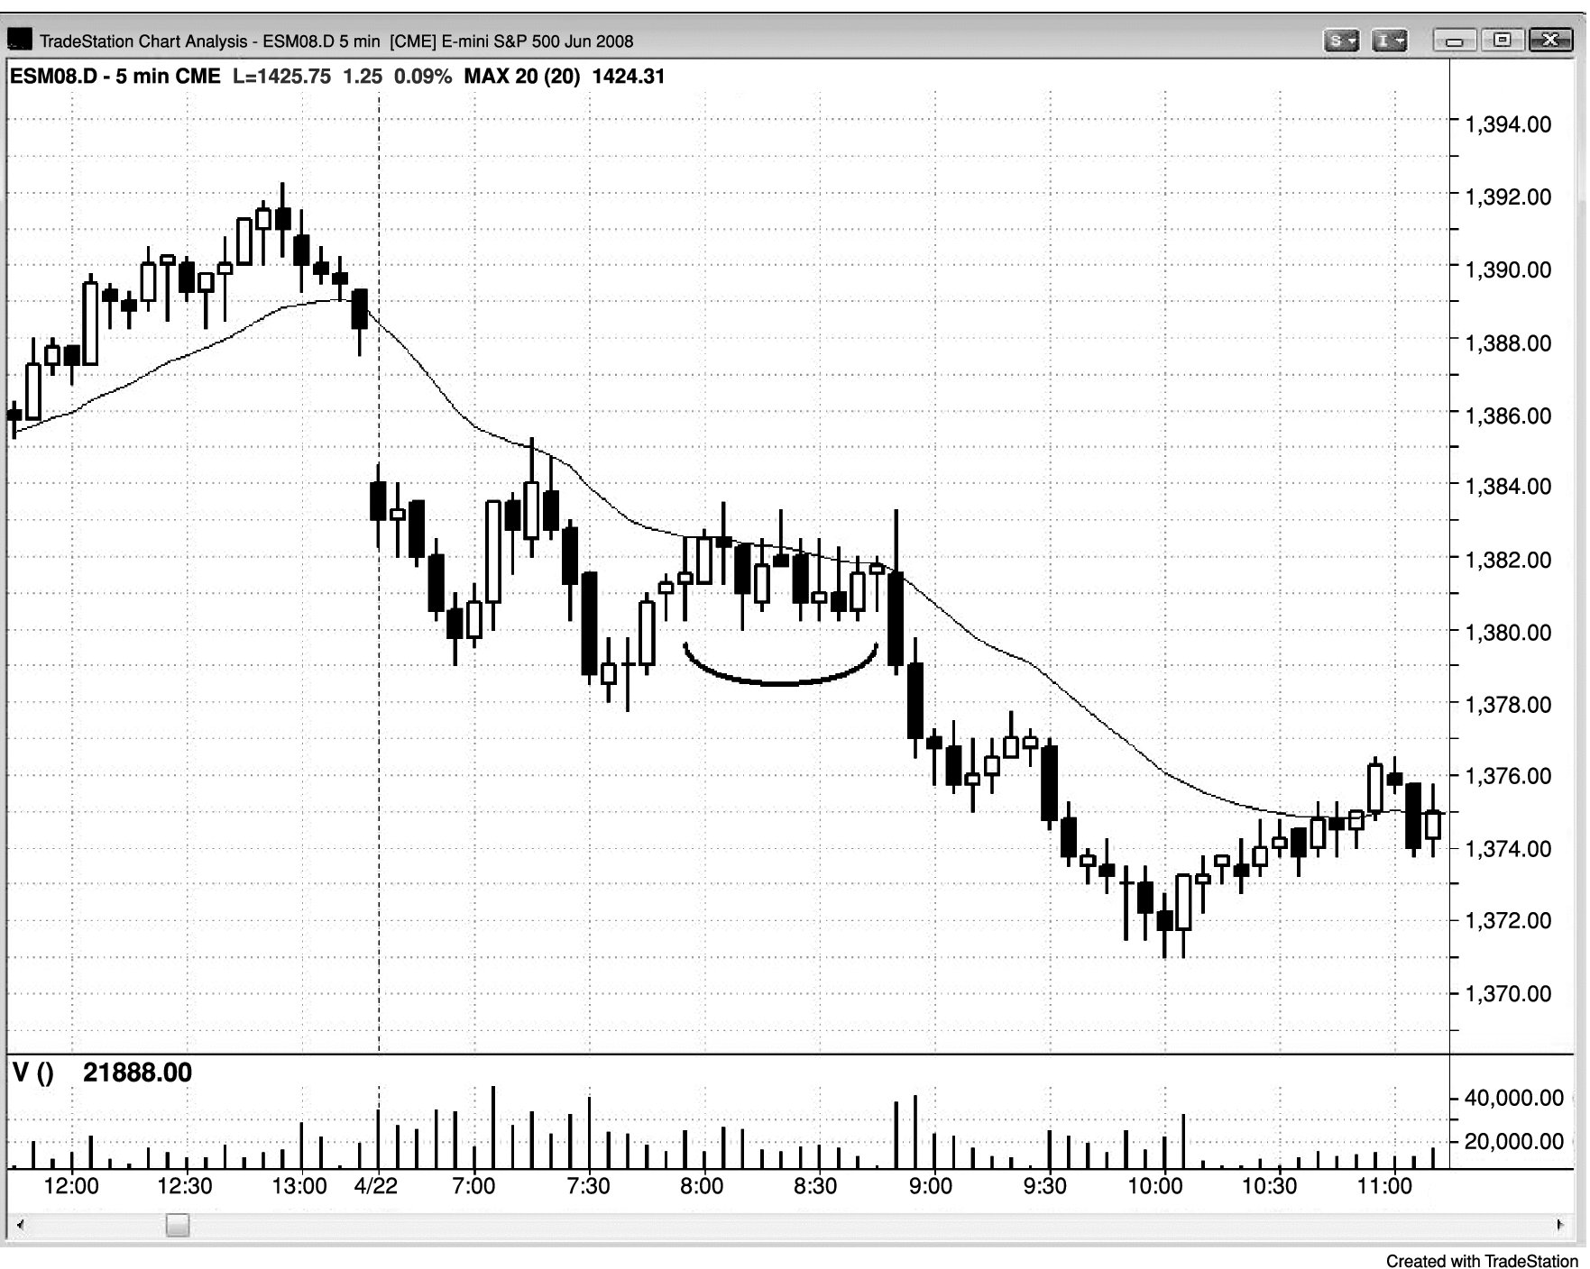
FIGURE 22.8 Barbwire Failed Breakout

Slide 9
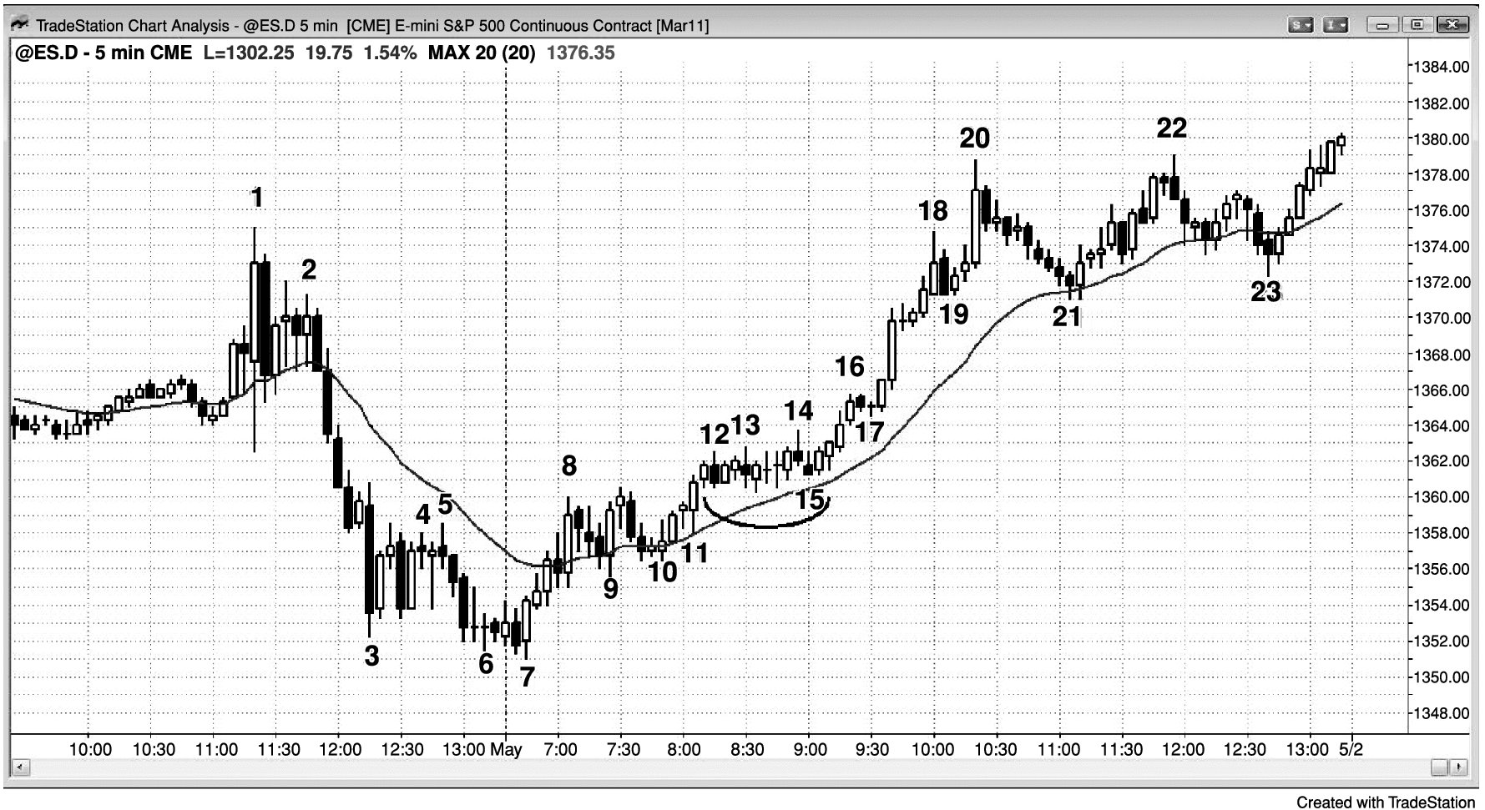
FIGURE 22.9 Tight Trading Range as a Flag

Slide 10
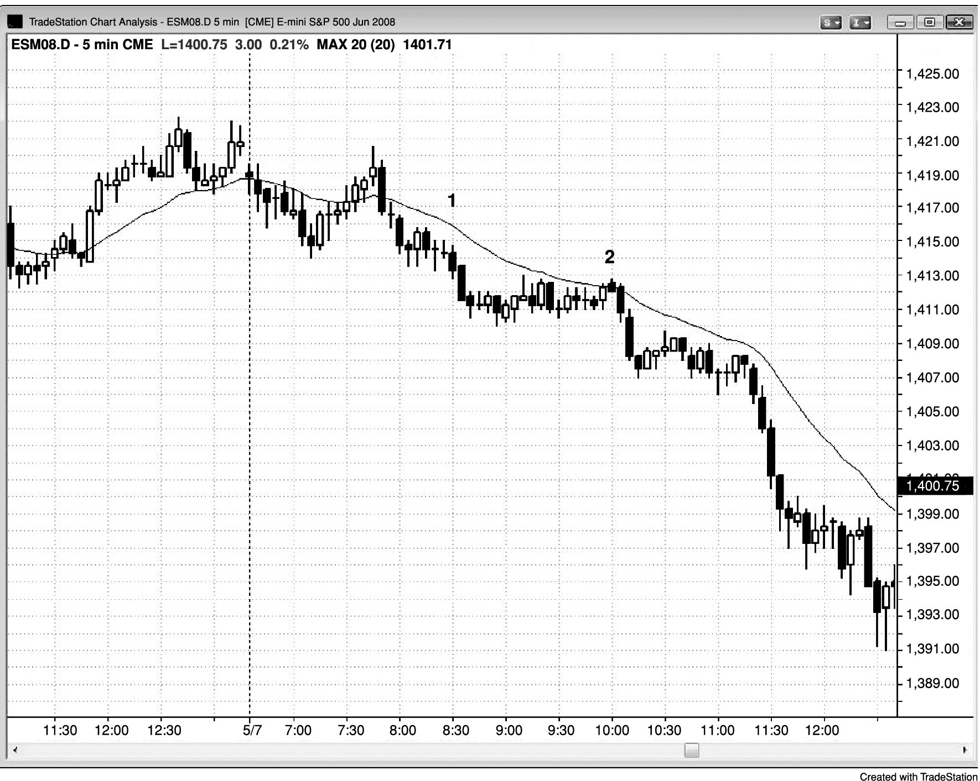
FIGURE 22.10 Tight Trading Range Bear Flag

Slide 11
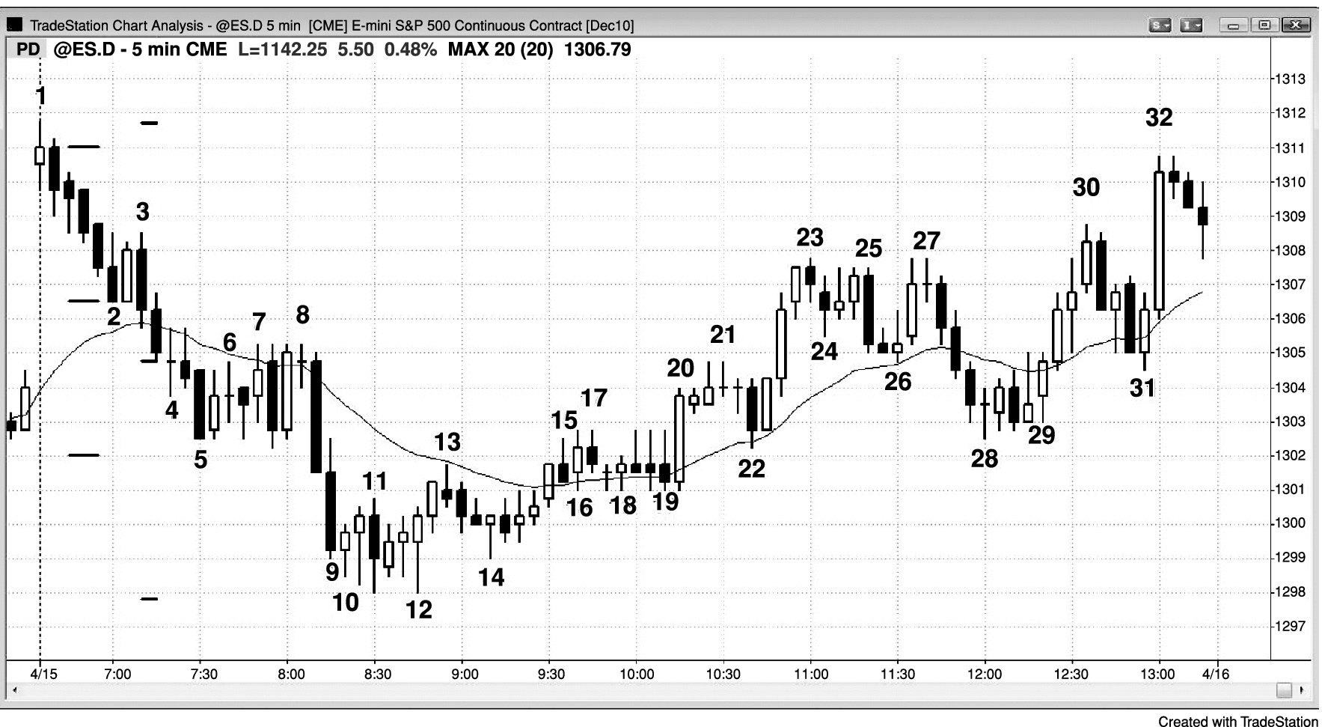
FIGURE 22.11 Barbwire Reversal

Slide 12
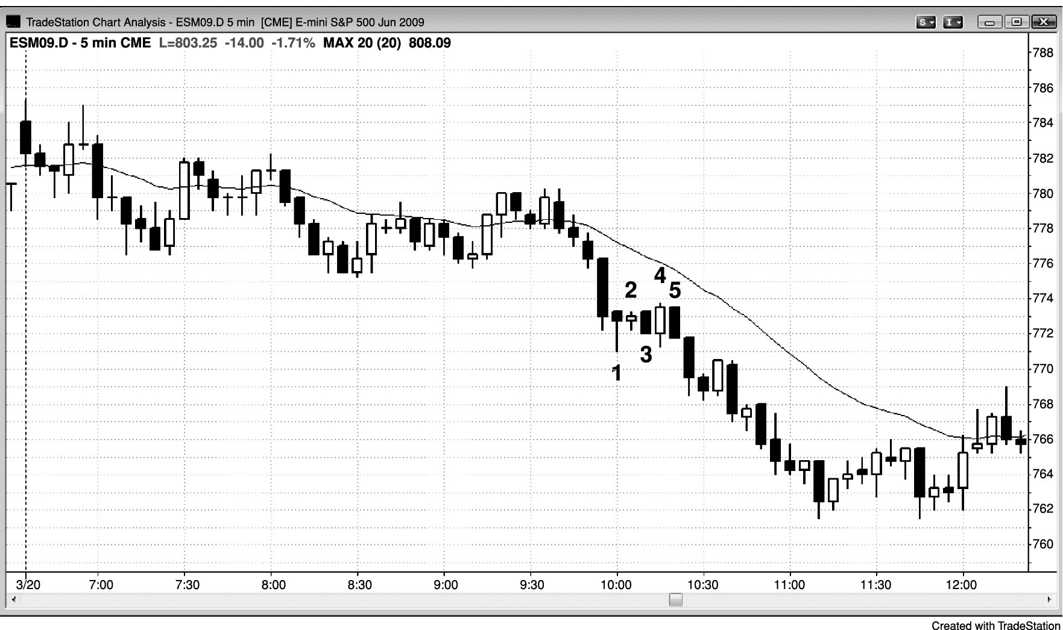
FIGURE 22.12 Barbwire as a Low 2

